Slide 1






QuickBird
Historical Forest Landscapes and Concession Dynamics in Liberia:
A Comparison Using the 1965
German Forestry Mission Inventory Map
EO-1
FOREST
FORUM
Rudolph J. Merab, Snr.
Managing Director
Forestry Development Authority
2025
3rd – 5th November
NigeriaSat-1

Slide 2

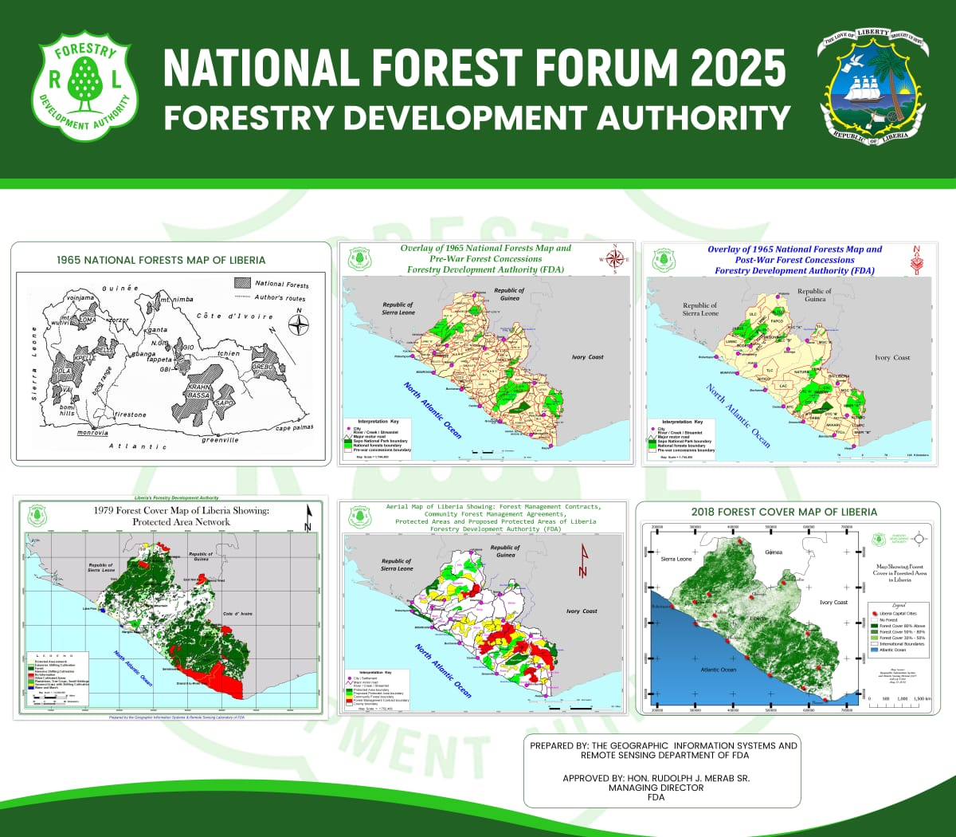


National Forests Map of Liberia 1965

Slide 3
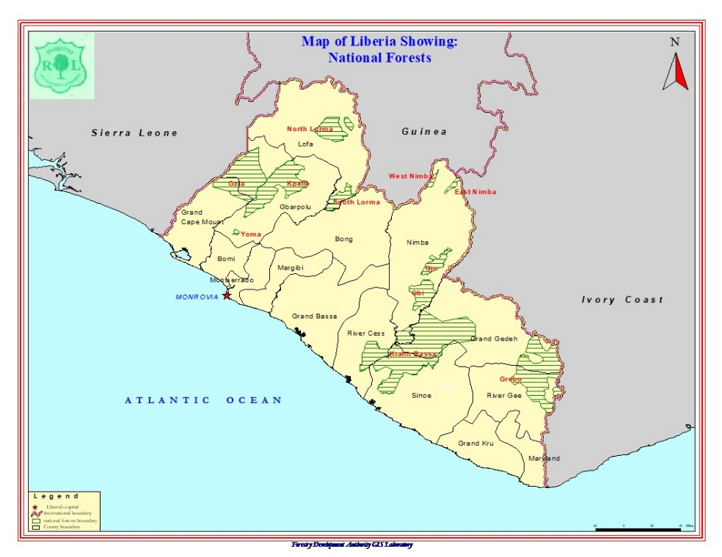

National Forest Map of Liberia 2003

Slide 4
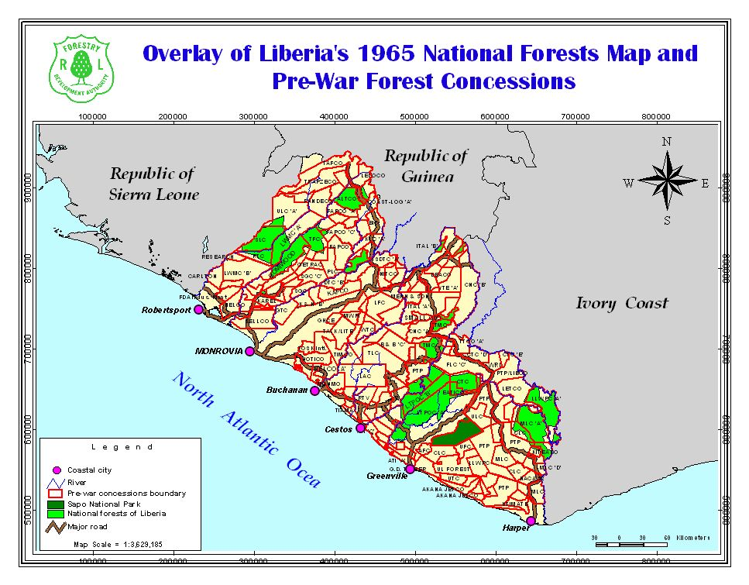

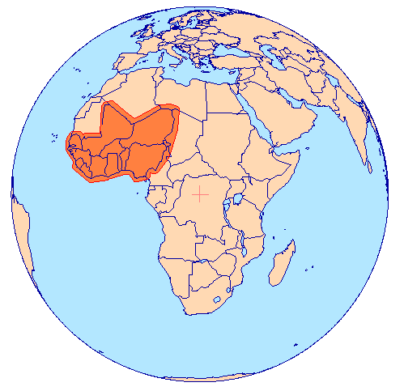

Slide 5
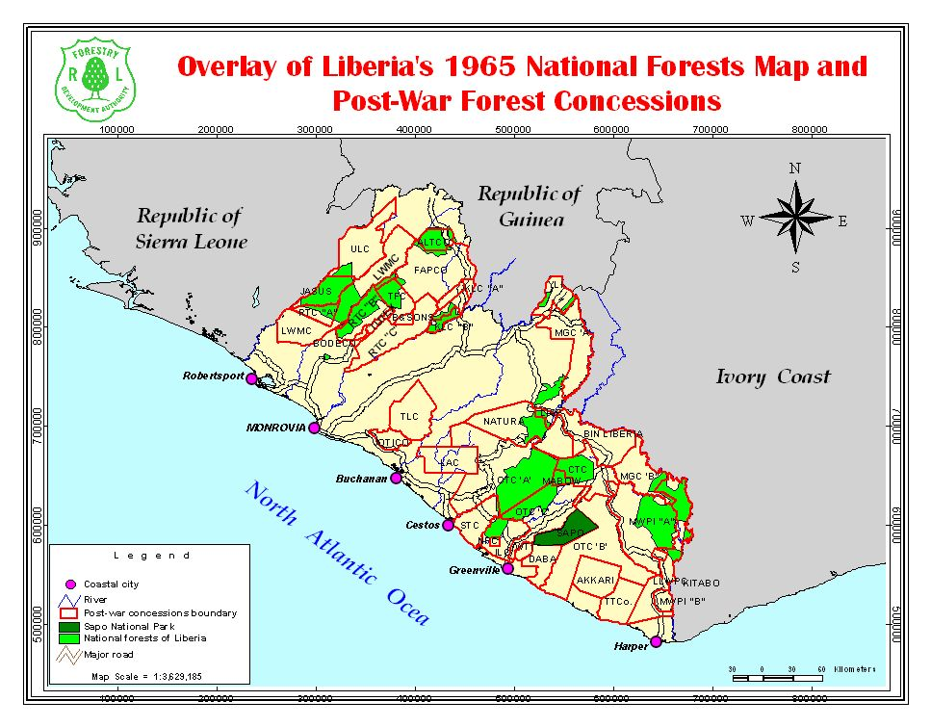


Slide 6
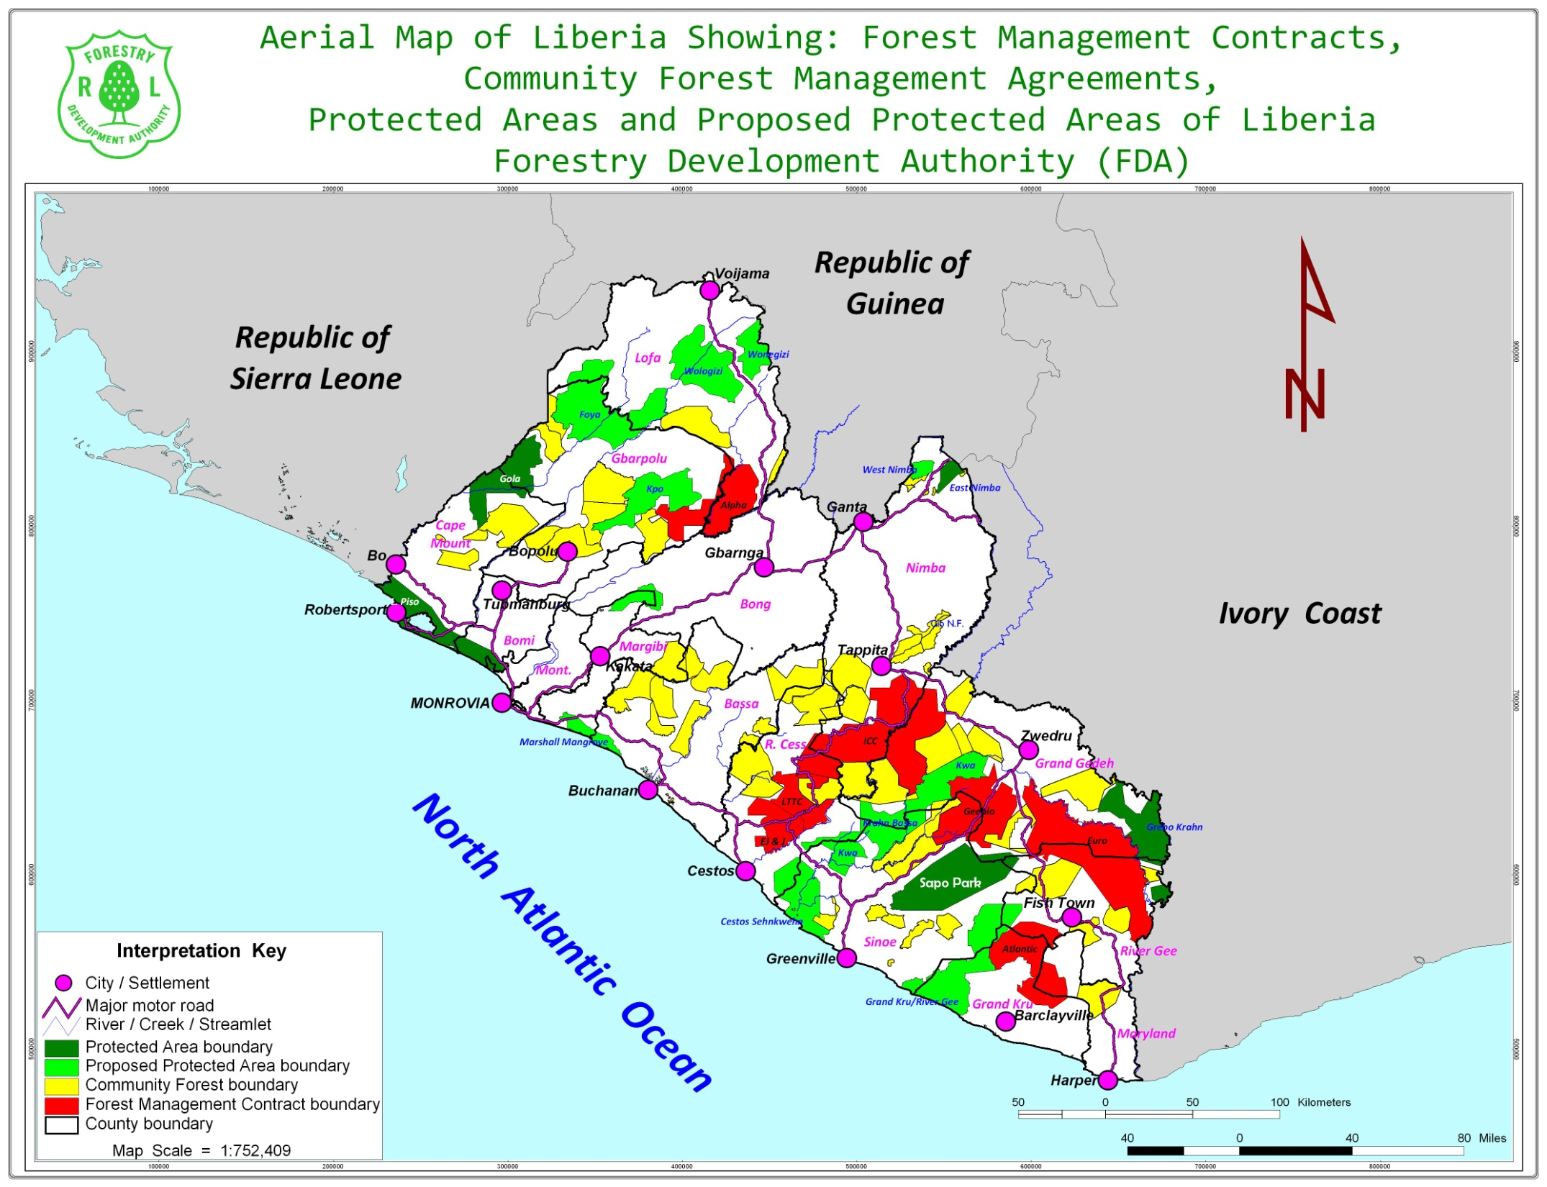

Slide 7
